Slide 1
EXPORT MARKETING
Dr. Sumita Shankar

Slide 2
NEGATIVE LIST OF EXPORT

Slide 3
PROHIBITED ITEMS
PROHIBITED ITEMS ARE THOSE ITEMS WHICH ARE TOTALLY BANNED FOR EXPORTS

Slide 4
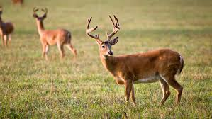
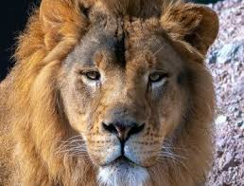
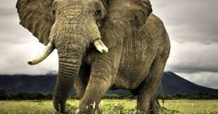
PROHIBITED ITEMS EXAMPLES
WILD ANIMALS

Slide 5
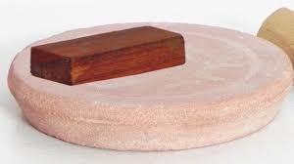
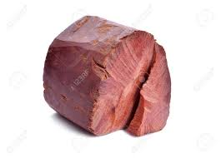
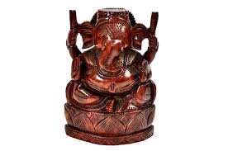
PROHIBITED ITEMS EXAMPLES
RED SANDAL WOOD

Slide 6
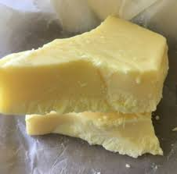
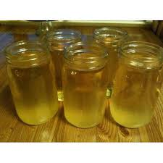
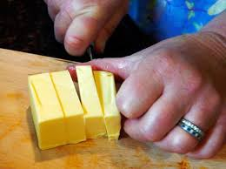
TALLOW/ FAT/ OIL OF ANIMAL ORIGIN

Slide 7
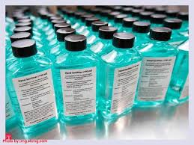
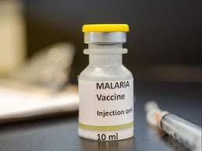
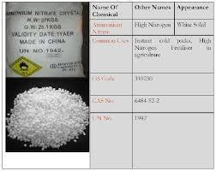
CHEMICALS NOTIFIED BY DGFT

Slide 8
RESTRICTED ITEMS
RESTRICTED ITEMS CAN BE IMPORTED OR EXPORTED WITH SPECIAL PERMISSION OR LICENCE FORM AUTHORITIES.

Slide 9
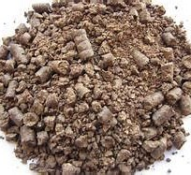
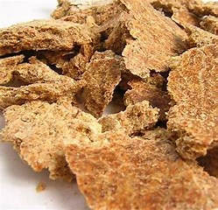
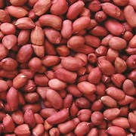
RESTRICTED ITEMS EXAMPLES DEOILED GROUNDNUT CAKE

Slide 10
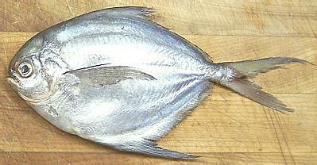
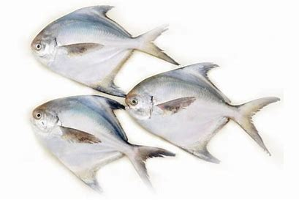
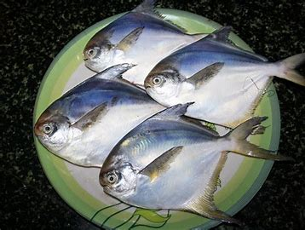
FRESH AND FROZEN SILVER PPMFRET

Slide 11
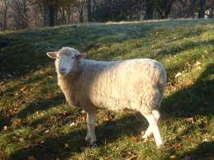
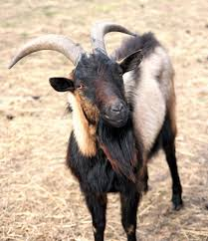
FUR OF DOMESTIC ANIMAL

Slide 12
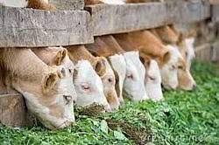
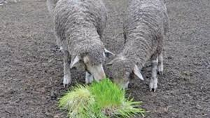
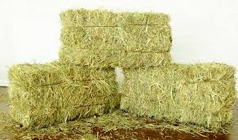
FODDER

Slide 13
The canalised items
THESE ARE THE ITEMS TO BE EXPORTED THROUGH CANALISING AGENCIES.

Slide 14
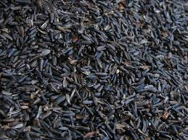
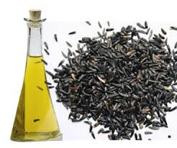
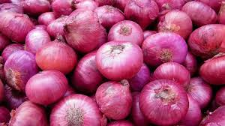
CANALISED ITEMS EXAMPLES NIGAR SEEDS , ONION,

Slide 15
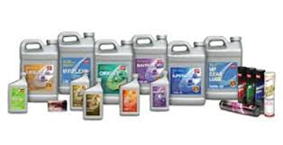
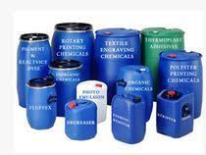
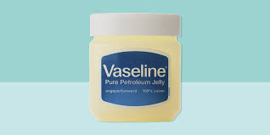
CANALISED ITEMS EXAMPLES PETROLEUM PRODUCTS

Slide 16
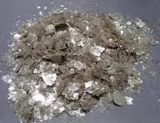
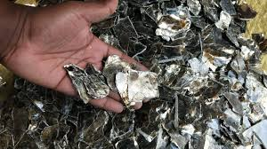
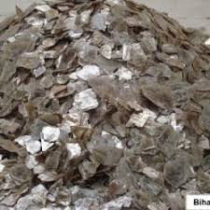
CANALISED ITEMS EXAMPLES MICA WASTE

